Slide 1
BATTLE OF NEIGHBORHOODS
NEW YORK CITY - PROPERTY SALES ANALYSIS TO FIND THE BEST HOME FOR YOU
KARTIK NAIR
JULY 2020

Slide 2
1.INTRODUCTION

Slide 3
1.1BACKGROUND
For people trying to find the best places to live, it's always a good idea to compare cities and if possible, to compare neighborhoods to see if its suites your taste and fits your budget. The cost of living in the neighbour hood and the amenities with the property and nearby it is a top concern when moving to a new area. For some its a restaurant nearby for some a coffee shop , in all everyone has their requirements which are needeed to be looked out for.

Slide 4
1.2 PROBLEM
The Property Sales dataset of New York has sales details with price of different types of houses sold in each borough of New York over the years 2010-2019. The market price of each place changes with time. This project aims to select the boroughs in NYC based on the highest number of sales, explore the neighborhoods of that borough to find the 10 most common venues in each neighborhood and finally cluster the neighborhoods using k-mean clustering.

Slide 5
2. Data

Slide 6
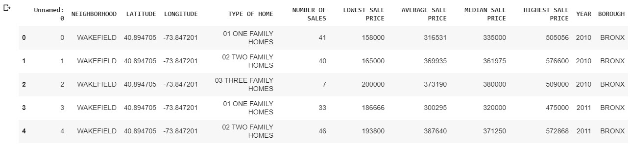
2.1 Dataset
2.1.1 NYC Property Sales Dataset
Let’s have a quick look at our dataset:-

Slide 7
Some Important Columns :
1.NEIGHBORHOOD:- This column has the neighborhood name of each sale
2. NUMBER OF SALES :- This numeric column indicates the total sales done in each neighborhood of a particular type of house.
3. BOROUGH :- This column is very important for our project this column indicates the borough of the sale .
And 11 more columns for now , some will be cleaned later and these columns are not relevant to our analysis either.

Slide 8
2.2 Data Cleaning
The New York Sales Dataset needs a few minor cleaning,
1.Duplicate rows needed to be removed
2.Uneccessary columns to be dropped
3.And Column Names to be renamed for further processes
4.Total number of sales per Borough needed

Slide 9

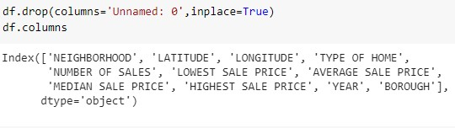

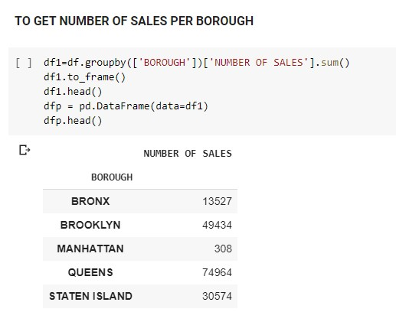
These all processes were done using the Pandas Library as follows :
.
.
.
.

Slide 10
3.METHODOLOGY

Slide 11
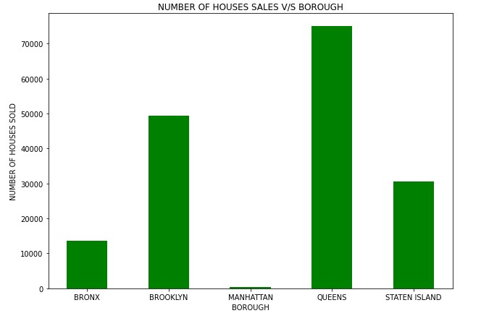
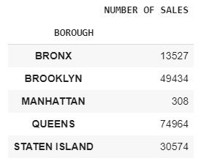
3.1.Exploratory Data Analysis
Let’s Visualize The Sales in each borough
Comparing five boroughs it is evident that Queens has the highest Property Sales recorded followed by Brooklyn, Staten Island, Bronx and Manhattan
It’s clearly seen that people prefer QUEENS than any other borough so that’s our first preference so we’ll explore this.

Slide 12
3.1.2 Neighborhoods in QUEENS
Exploring the Queens Borough showed that only a single borough won’t have enough neighbourhoods for a person to choose from . Hence under this case we will take 3 Borough with most property sales which are
QUEENS
BROOKLYN
STATEN ISLAND

Slide 13
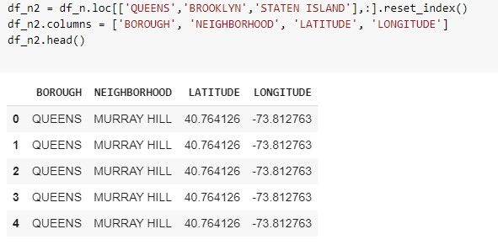
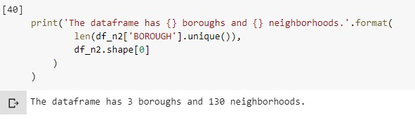
3.1.3 Visualize the neighbourhoods
Firstly, we select the neighbourhoods only from these 3 Boroughs,
that is Bronx, Queens and Staten Island, and save them in a new dataframe.
We find that there are 130 neighbourhoods recorded in the 3 Boroughs

Slide 14
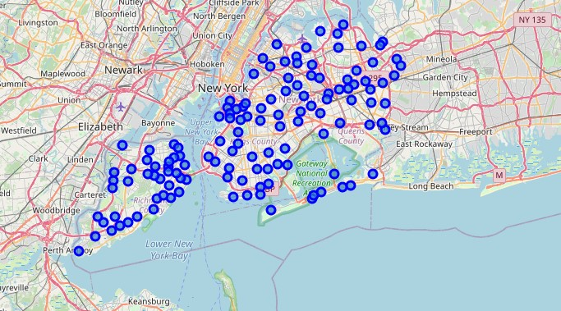
To visualize this we use the Folium Library

Slide 15
3.2Modelling
Using the final dataset containing the neighbourhoods with the
latitude and longitude, we can find all the venues within a 500 meter
radius of each neighbourhood by connecting to the Foursquare API.
This returns a json file containing all the venues in each
neighbourhood which is converted to a pandas dataframe. This data
frame contains all the venues along with their coordinates and
category.

Slide 16
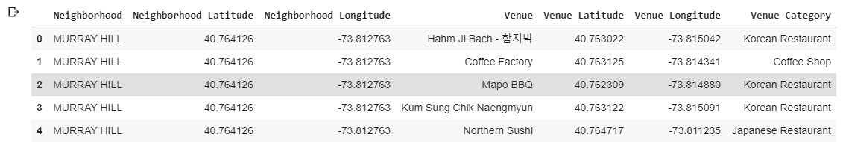
One hot encoding is done on the venues data. (One hot encoding is a
process by which categorical variables are converted into a form that
could be provided to ML algorithms to do a better job in prediction).
The Venues data is then grouped by the Neighbourhood and the
mean of the venues are calculated, finally the 10 common venues
are calculated for each of the neighbourhoods.
To help people find similar neighbourhoods in the safest borough we
will be clustering similar neighbourhoods using K - means clustering
which is a form of unsupervised machine learning algorithm that
clusters data based on predefined cluster size. We used the elbow
method to find the best cluster size and found 5 clusters to be ideal.

Slide 17
The reason to conduct a K- means clustering is to cluster
neighbourhoods with similar venues together so that people can
shortlist the area of their interests based on the venues/amenities
around each neighbourhood.

Slide 18
4.Results

Slide 19
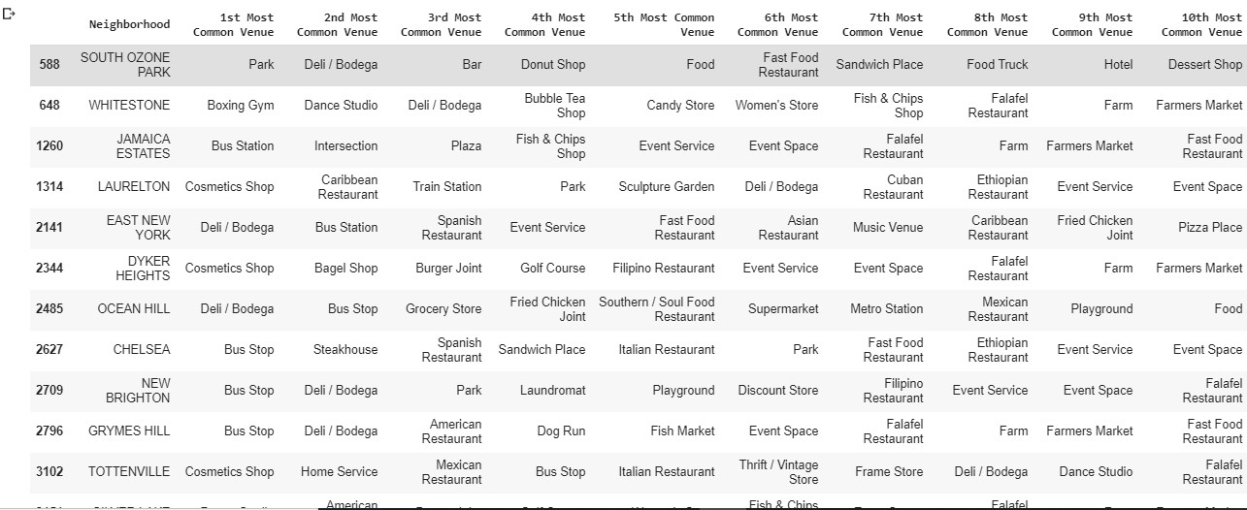
After running the K-means clustering we can access each cluster
created to see which neighborhoods were assigned to each of the five clusters. Looking into the neighborhoods in the first cluster .

Slide 20
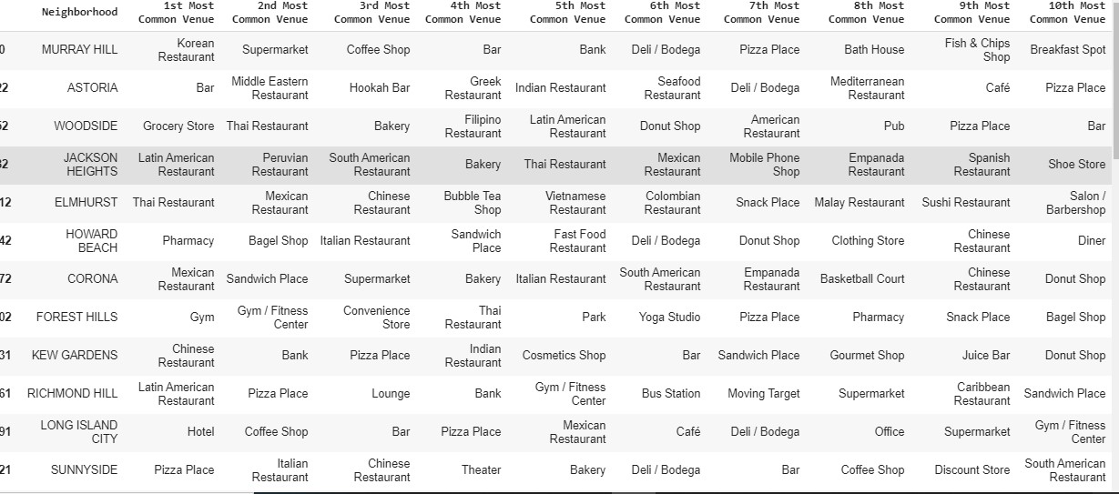
Upon closely examining these neighborhoods we can see that the most common venues in these neighborhoods are Bus Stop, Coffee shops and restaurants.
Similarly looking at the 2nd cluster we see that it mainly consists of the neighbourhoods with venues such as be Bar, Pizza Place, Pharmacy.

Slide 21
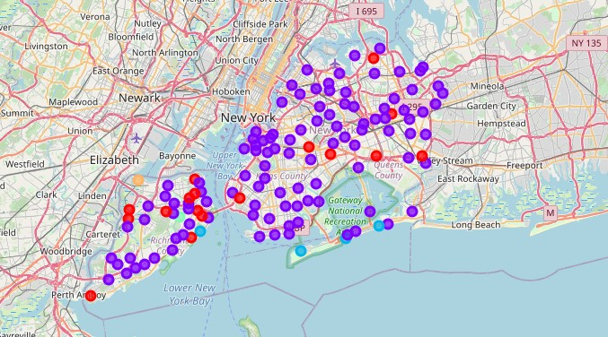
Similarly, we can examine each cluster to find out which neighbourhoods suits our best interest by looking at the most common venues.
Finally lets visualize the clustered neighbourhoods using Folium Library.

Slide 22
5. Discussion

Slide 23
The aim of this project is to help people who want to relocate to the Best borough in New York city, expats can choose the
neighbourhoods to which they want to relocate based on the most common venues in it. For example, if a person is looking for a neighbourhood with good connectivity and public transportation we can see that Cluster 1 has and Bus stops as the most common venues. If a person is looking for a neighbourhood with stores and restaurants in a close proximity, then the neighbourhoods in the second cluster is suitable. The choices of neighbourhoods may vary from person to person.

Slide 24
6.Conclusion

Slide 25
This project helps a person get a better understanding of the
neighbourhoods with respect to the most common venues in that neighbourhood. It is always helpful to find out more about places before moving into a neighbourhood.We have just taken Price(Budget) as a primary concern to shortlist the best boroughs in New York city. The future of this project includes taking other factors such as saefty in the areas into consideration to shortlist the borough, such as filtering areas based on a Number of Crimes Recorded in the Borough.

